Slide 1
Assignment 2 Presentation EECE 443 Team 2: MCU TNC Design Kaleb Leon – C00094357 Kobe Keopraseuth – C00092349 David Cain – C00043561 March 20th, 2020

Slide 2
MCU TNC Assignment 2
David Cain, Kobe Keopraseuth, and Kaleb Leon

Slide 3
Preliminary Design
Simulations
BJT PNP Circuit - http://tinyurl.com/uvuus54
Voltage Divider - http://tinyurl.com/tjcqvlk
Calculations
Drawings
Bill of Materials
Instructions of Assembly
Failure Mode Effects Analysis
Level 0/Level 1 Diagram

Slide 4
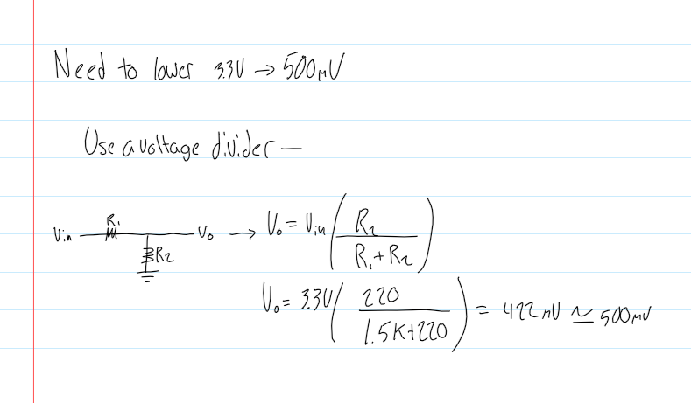
Calculations
Voltage Divider Calculations

Slide 5
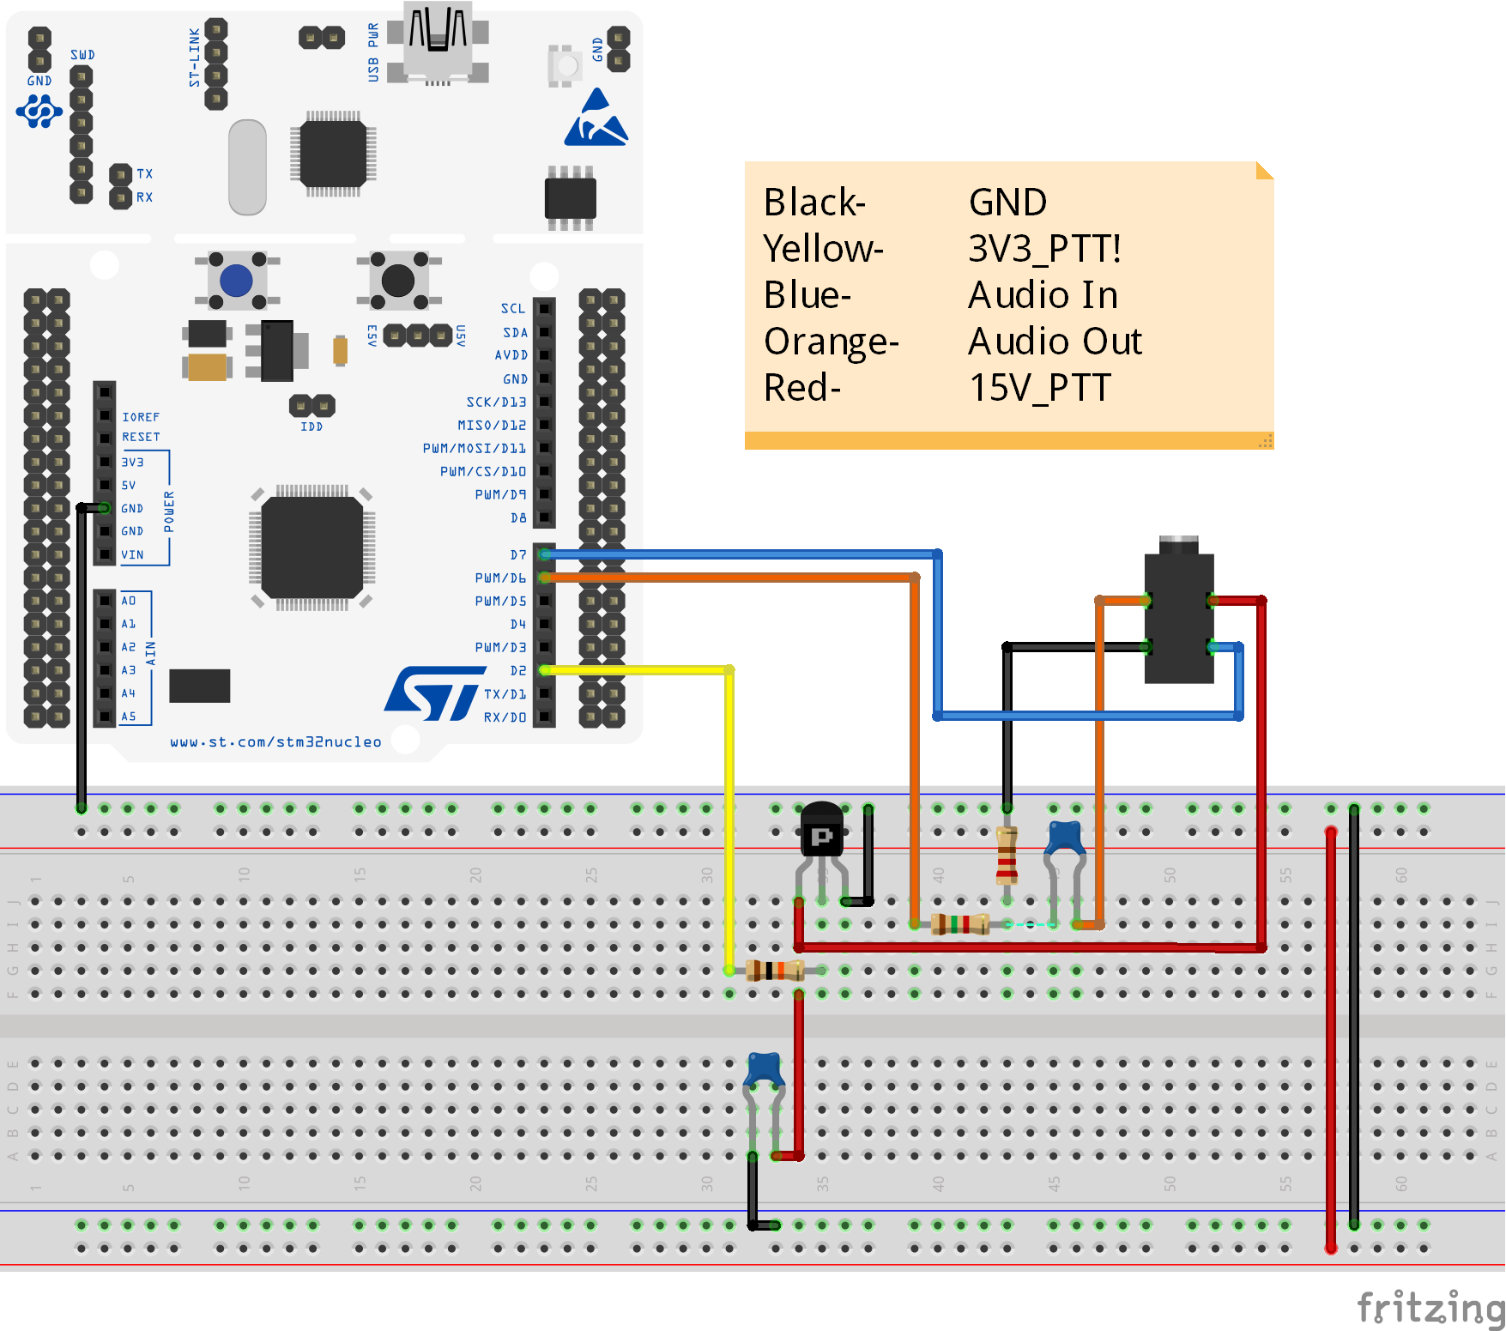
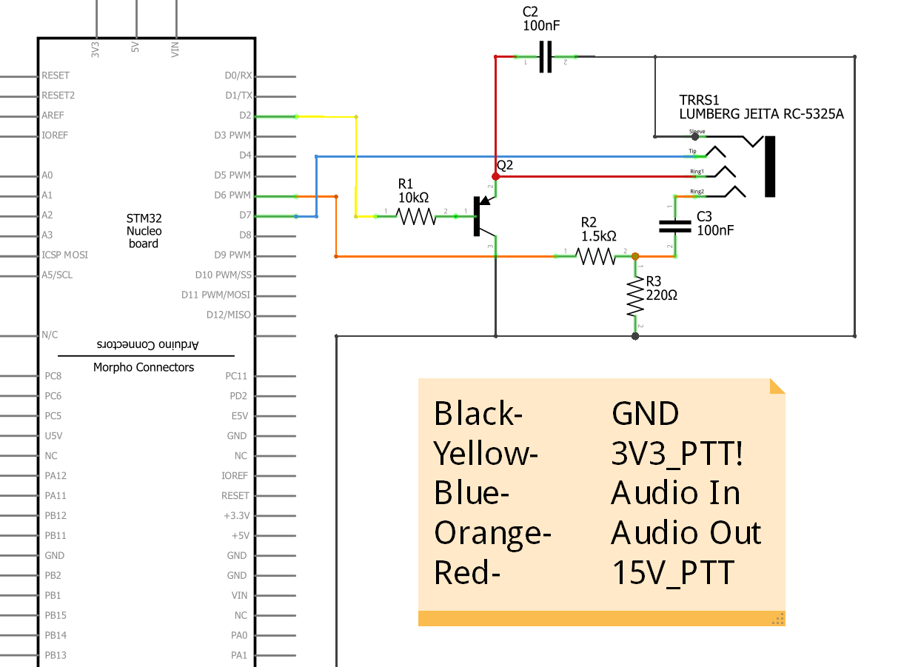
Drawings
Breadboard Layout
Schematic Layout

Slide 6
Bill of Materials
Bill of Materials Sent to Mentors

Slide 7
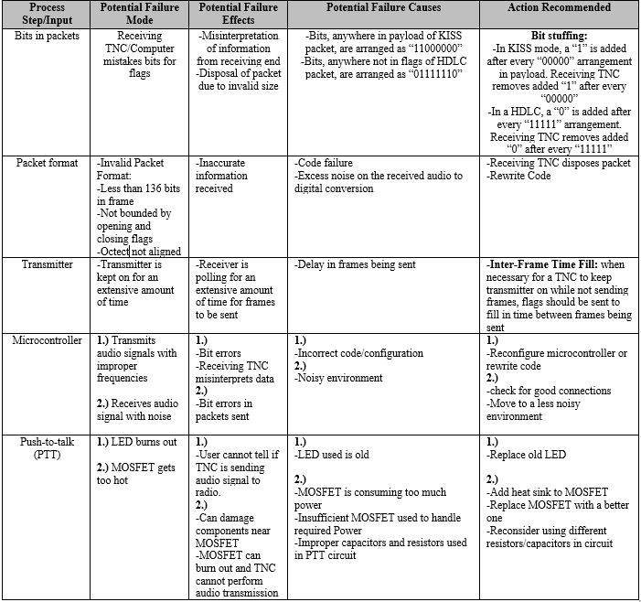
Failure Mode Effects Analysis
Failure Mode Effects Analysis

Slide 8
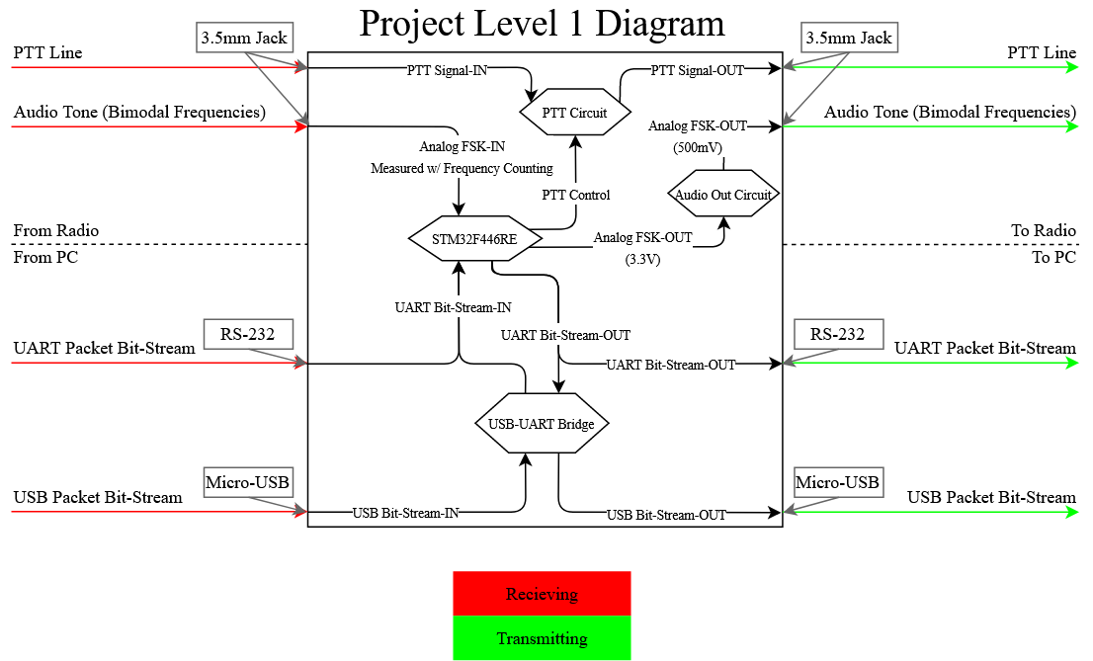
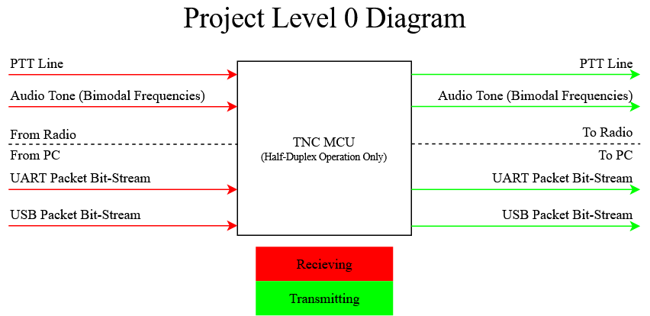
Level 0/Level 1 Diagrams
Level 0 Diagram
Level 1 Diagram

